Slide 1


Angular
Section 3
TA/Abdelrahman Hanfi

Slide 2
Angular
Reminder
a popular, open-source, TypeScript-based frontend web framework developed by Google for building fast, scalable single-page applications (SPAs)

Slide 3
Angular
Component-Based: Applications are built using modular components that combine logic and UI, making code reusable and easier to maintain.
TypeScript-Based: It utilizes TypeScript, offering strong typing and modern JavaScript features to improve code quality and developer experience.

Slide 4
Angular
Fully Featured: It includes built-in tools for routing, form validation, and server communication (HTTP Client).
Two-Way Data Binding: Automatically synchronizes data between the model (TypeScript) and the view (HTML), reducing manual DOM manipulation.
Dependency Injection: A powerful feature that manages service dependencies, improving testability and modularity.
Angular CLI: A powerful command-line interface tool to create projects, add files, and perform ongoing development tasks like testing and deployment.

Slide 5
A Framework
a set of pre-written code, libraries, and tools—typically based on JavaScript, HTML, and CSS—used to build user interfaces for web applications more efficiently.
They provide a structured, component-based approach to handle dynamic data, state management, and DOM manipulation, speeding up development and ensuring consistency.

Slide 6
Feeling lost ?
It is completely normal to feel lost with Angular at first! It is a "heavy" framework because it does a lot for you, but that means there are many moving parts to learn.
Think of Angular as a Construction Set. Instead of writing one giant, messy HTML file, you build small, organized "bricks" (Components) and "tools" (Services).

Slide 7
1. What is a Component? (The "Brick")
A component is a single piece of your website (like a Navbar, a Login Box, or a Profile Card).
Every component is made of three files working together:
The HTML (.html): The "Skeleton." This defines what is on the screen (buttons, text).
The CSS (.css): The "Clothes." This makes it look good.
The TypeScript (.ts): The "Brain." This is where you write the logic (what happens when a button is clicked).

Slide 8
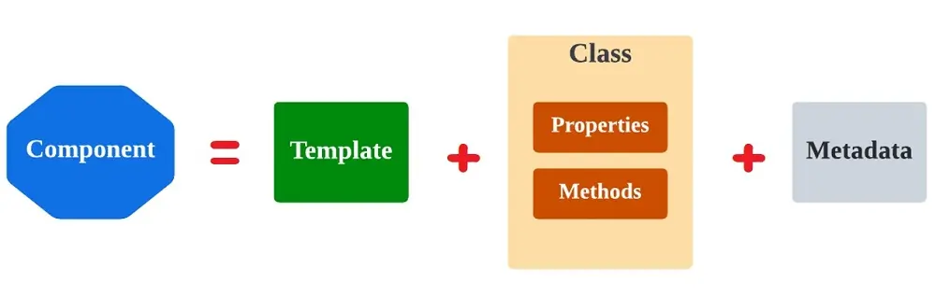
1. What is a Component? (The "Brick")

Slide 9
2. What is a Service? (The "Utility")
Imagine you have 10 different components. All of them need to know the name of the user who is logged in.
The wrong way: Writing login logic inside all 10 components.
The Angular way: Create one Service.
A Service is a "Global Data Hub." It stays in the background and holds data or functions that any component can "call" and use. It keeps your components from getting "cluttered."

Slide 10
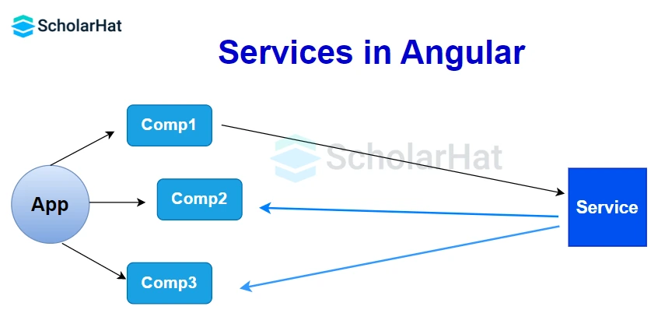
2. What is a Service? (The "Utility")

Slide 11
3. How do they talk? (Data Binding & Signals)
In your code, you saw signal('section3'). Think of a Signal like a Live Notification.
In the Brain (.ts): You define a signal: count = signal(0).
In the Skeleton (.html): You display it: {{ count() }}.
The Magic: The moment you change that number in the brain, the skeleton updates instantly without refreshing the page.

Slide 12
3. How do they talk? (Data Binding & Signals)
In your code, you saw signal('section3'). Think of a Signal like a Live Notification.
In the Brain (.ts): You define a signal: count = signal(0).
In the Skeleton (.html): You display it: {{ count() }}.
The Magic: The moment you change that number in the brain, the skeleton updates instantly without refreshing the page.

Slide 13
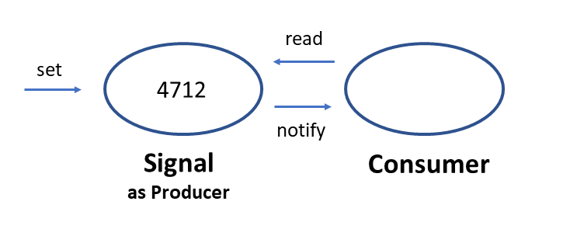
3. How do they talk? (Data Binding & Signals)

Slide 14
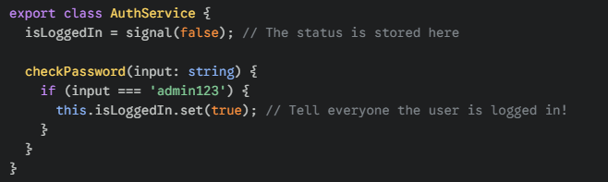
4.Login Example
Let's look at how a Component and Service work together in a real scenario:
The Service (The "Office")
The Service handles the "Work." It checks if the password is correct.

Slide 15
The Component (The "Counter")
The Component handles the "User." It shows the input box and the button.
The User types a password.
The Component sends that password to the Service.
The Component "watches" the isLoggedIn signal. As soon as it becomes true, the Component hides the login box and shows a "Welcome" message.

Slide 16
Why this is better than plain HTML/JS?
n plain JavaScript, you would have to manually find the HTML element, change the text, and hide the div using document.getElementById. It gets messy fast.
In Angular:
You change the data in the Service.
The Signal notifies the Component.
The HTML updates itself automatically.

Slide 17
Summary
Component: "I show the UI and talk to the user.“
Service: "I hold the data and do the heavy logic.“
Signal: "I am the messenger that keeps them both in sync."

Slide 18
Thank you

